Slide 1
SEMESTER 1
TRACK ENTREPRENEURSHIP

Slide 2
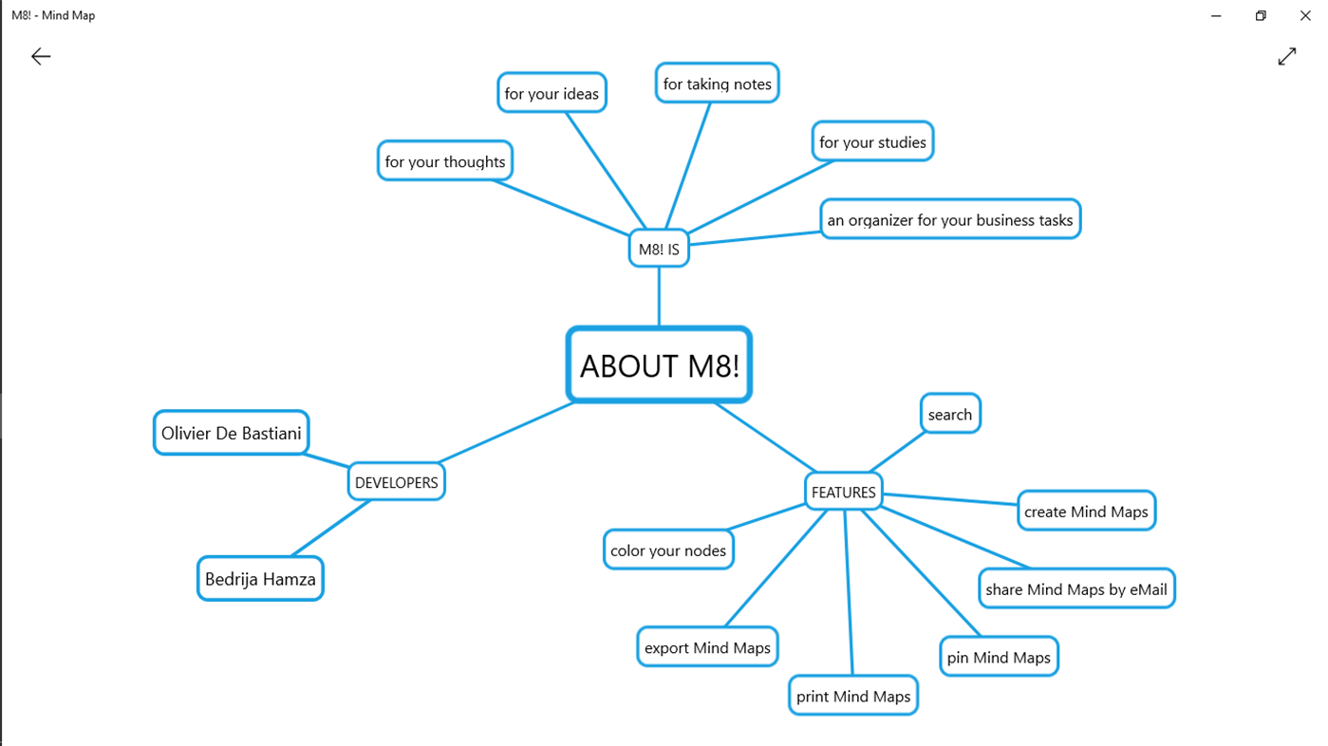
Phase 1 Idea
Tools : Mind maps
Learning Outcome : Student can explain their initial idea

Slide 3
Phase 2 Opportunity Ideation
Vertical Market | Product | Service | Trade | Subscription | Marketplace | Brokerage | Ecosystem
Tools : Ideation matrix
Learning Outcome : Student understand correlation between their idea & selected business models

Slide 4
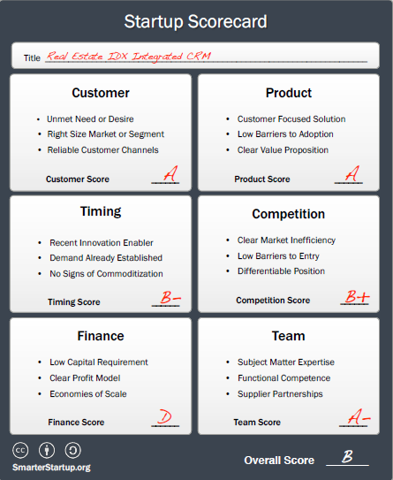
Phase 3 Opportunity Evaluation
Tools : Startups scorecards
Learning Outcome : Student can choose one of the best idea from their current ideas

Slide 5
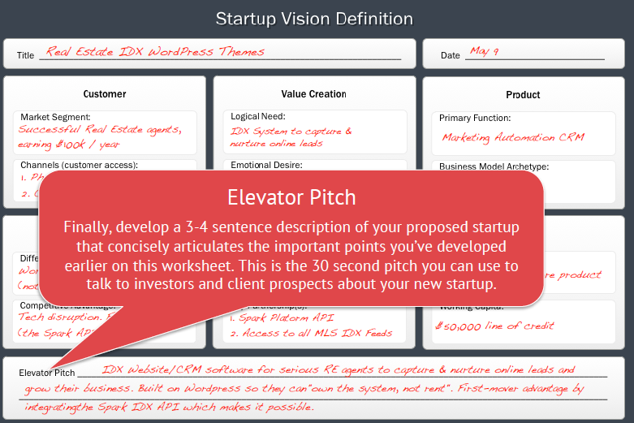
Phase 4 Startup Vision Definition
Tools : Vision definition matrix
Learning Outcome : Student can explain their selected idea into business vision

Slide 6
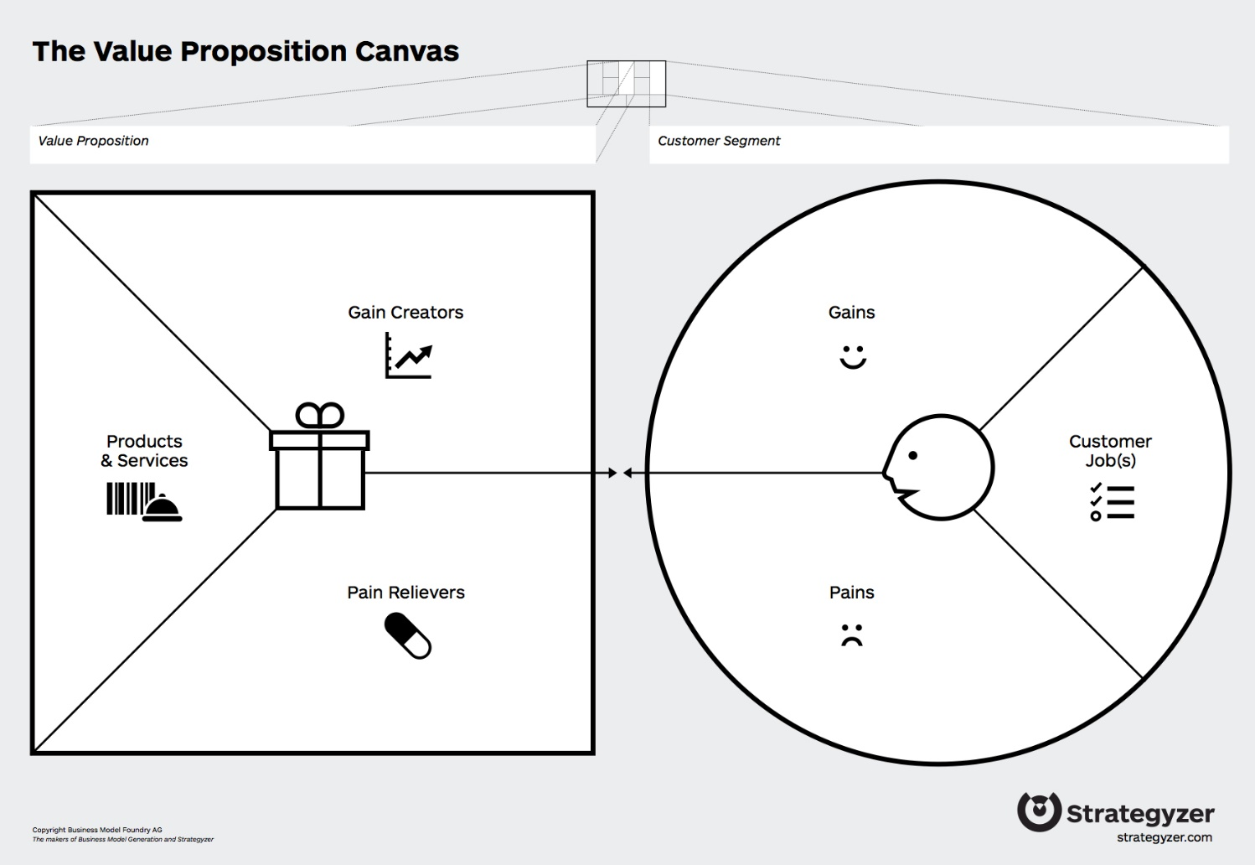
Phase 5 Value Proposition
Tools : Customer profile and Value Proposition Canvas
Learning Outcome : Student can identify their customer profile, customer pain, customer gain and propose product or services as a solution

Slide 7
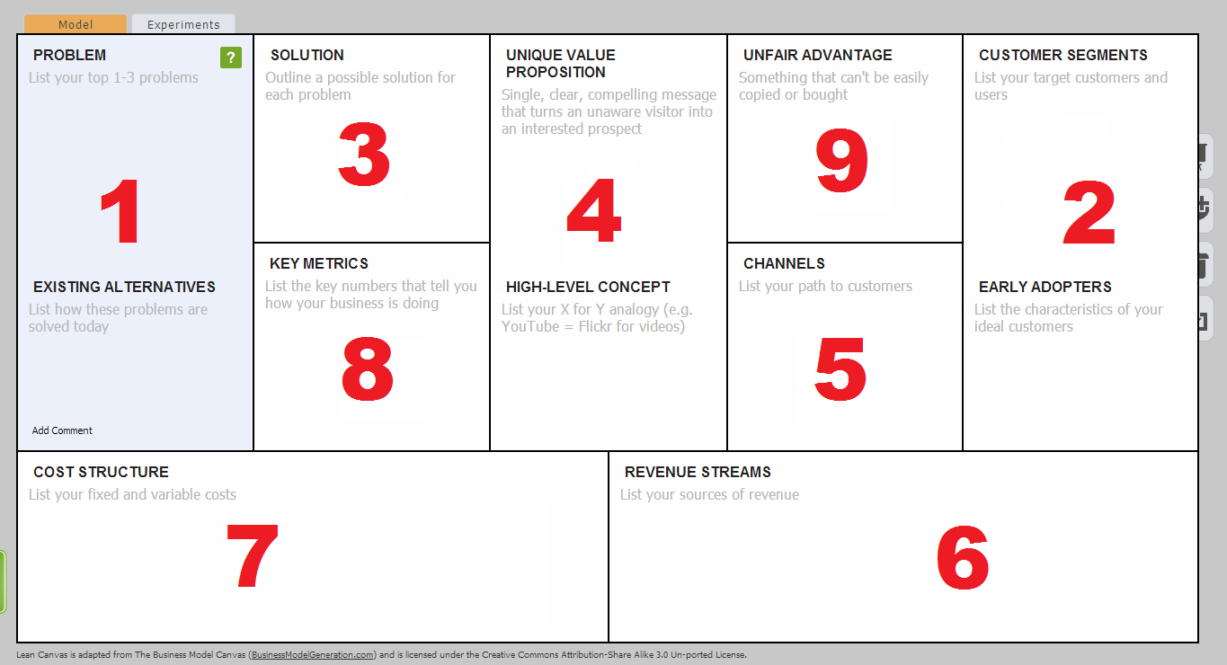
Phase 6 Problem-Solution Business Model
Tools : Lean Canvas
Learning Outcome : Student can connect between customer problem and their solution and translate it into proposes business model

Slide 8
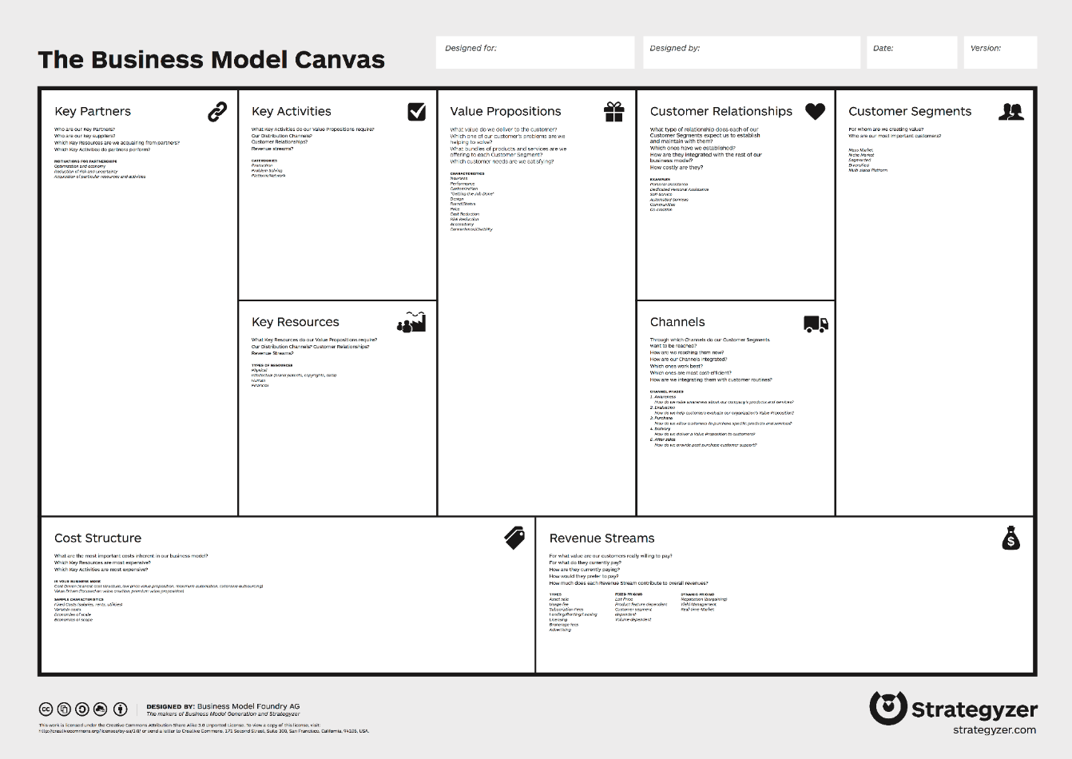
Phase 7 Holistic Business Model
Tools : Business model canvas
Learning Outcome : Student able to create holistic business model

Slide 9
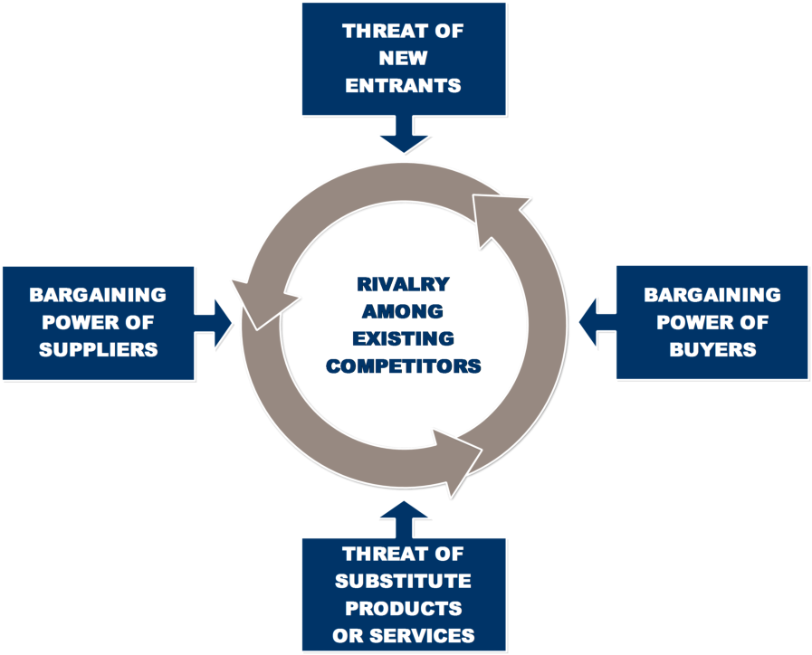
Phase 8 External Environment
Tools : 5 Forces Porter
Learning Outcome : Student understand external variable that influence their business

Slide 10
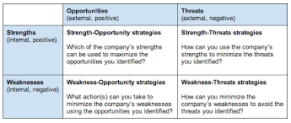
Phase 9 Risk Analysis
Tools : TOWS Analysis
Learning Outcome : Student identify risks to their business and develop strategies to minimize the impact to their business

Slide 11
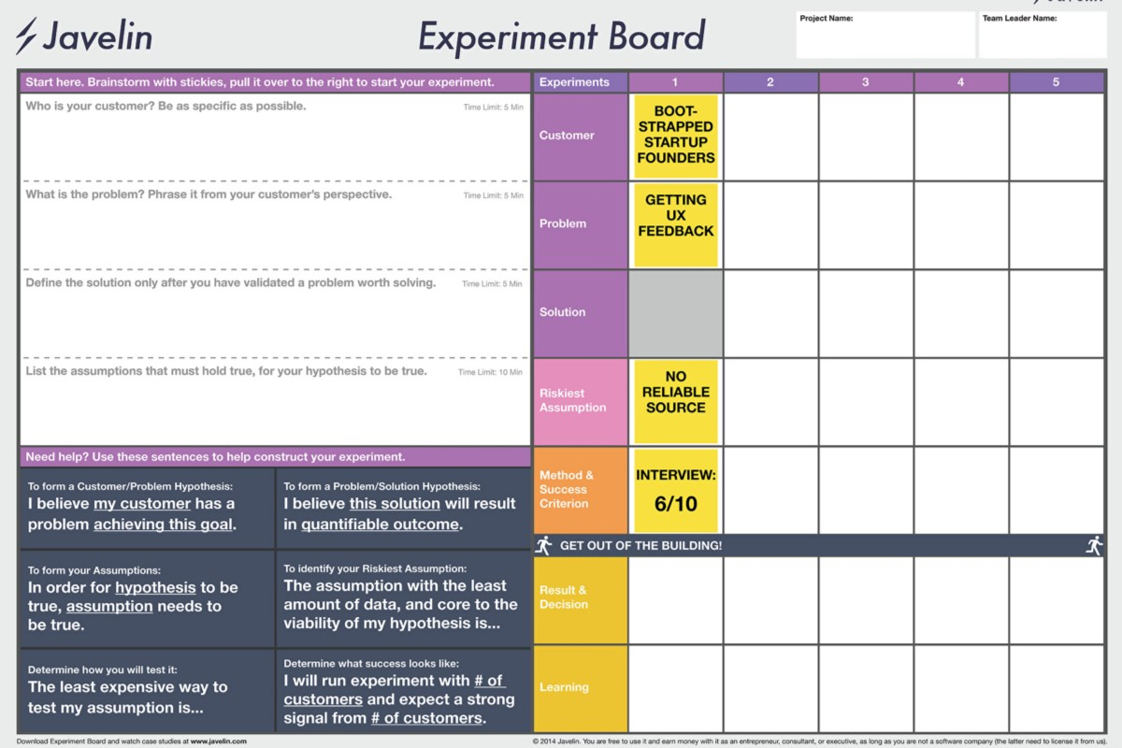
Phase 10 Experiment and Validation
Tools : Javelin board or Validation board
Learning Outcome : Student able to conduct experiment based on their idea and validate it to potential customer

Slide 12
Phase 11 Prototyping
Tools : Student prototype
Learning Outcome : Student able to create their prototype

Slide 13
Phase 12 Validating Prototype
Tools : Interview and Questionnaire
Learning Outcome : Student able to validate their prototype to real customer

Slide 14
Phase 13 Business Presentation
Tools : Pitch deck
Learning Outcome : Student able to present their business to external partner ( angel investor , venture capital, faculty member)

Slide 15
Thank You

